Slide 1

the naked page objects
and their offspring
Daryn Holmes

Slide 2
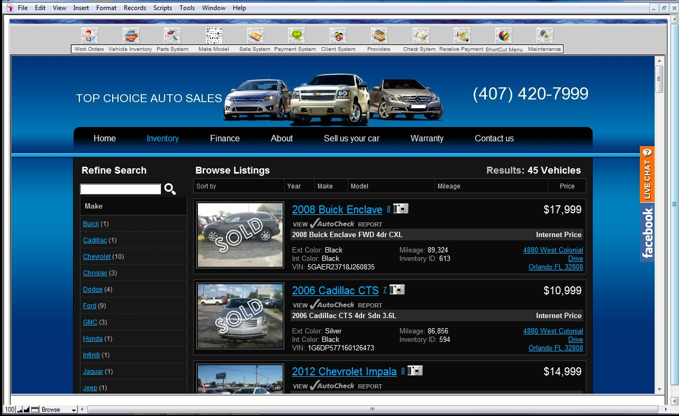
What is a page object?
Test
PageObject

Slide 3
Why naked?
3rd Party Framework
PageObject

Slide 4
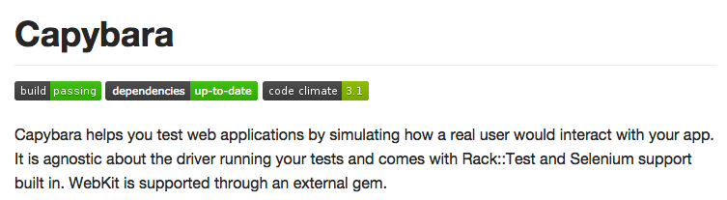
Capybara

Slide 5
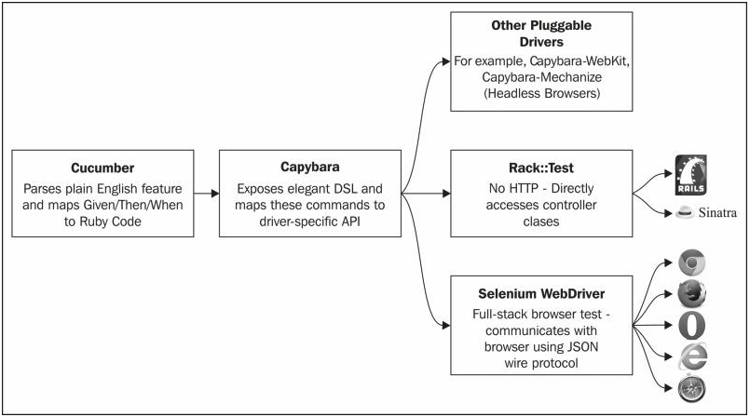
Flow from Cucumber to Driver

Slide 6



HTML & CSS Selectors
HTML
Fundamental CSS Selectors
<!DOCTYPE html>
<html>
<head>
<title>Heading Example</title>
</head>
<body>
<h1 class='large bold'>Title</h1>
<p id='thing'>This is a paragraph</p>
</body>
</html>
Element
ID
class
scoping
h1
#thing
.bold
body .bold

Slide 7
HTML, CSS & Capybara
HTML
CSS Selectors
Capybara Finders
<!DOCTYPE html>
<html>
<head>
<title>Heading Example</title>
</head>
<body>
<h1 class='large bold'>Title</h1>
<p id='first'>This is a paragraph</p>
</body>
</html>
h1
#thing
.bold
body .large
find(‘h1’)
first(‘#thing’)
all(‘.large’)
within(‘body’) do
find(‘.bold’)
end

Slide 8
Capybara
Node Element API
High level DSL
find(‘#name’).text
find(‘#name’).set(‘Bob’)
first(‘#home’).click
fill_in ‘name’ with: ‘Bob’
click_link ‘Home’
click_button ‘save’

Slide 9
Flow from Cucumber to Driver

Slide 10
Unofficial Mental Modal Capybara with Selenium WebDriver
Tests
Custom Test Code
Page Objects
Capybara
Common High level API
Selenium WebDriver
Ruby bindings
Firefox
Chrome
…
Remote Drivers
Firefox
Chrome
…
Browsers
Web Application
System Under Test

Slide 11
Unofficial Mental Modal Capybara with Selenium WebDriver
Tests
Custom Test Code
Page Objects
Capybara
?
Common High level API
Selenium WebDriver
Ruby bindings
Firefox
Chrome
…
Remote Drivers
Firefox
Chrome
…
Browsers
Web Application
System Under Test

Slide 12
Capybara & Selenium Web Driver
Capybara
Selenium WebDriver
visit(‘http://…)
find(‘#name’).text
find(‘#name’).set(‘Bob’)
first(‘#home’).click
b.get(‘http:/…’)
b.find_element(:id, ‘name’).text
b.find_element(:link, ‘Home’).send_keys(‘Bob’)
b.find_element(:id, ‘home’).click
b is the browser object e.g.
b = Selenium::WebDriver.for(:firefox)

Slide 13


Slide 14
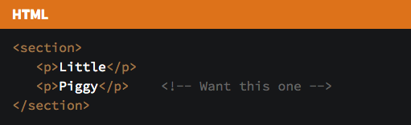
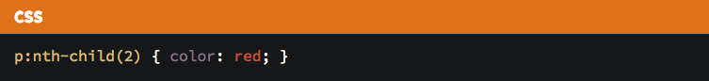
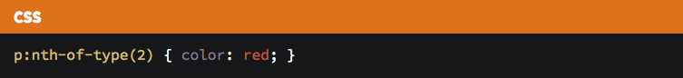
CSS: nth-child & nth-of-type
Notes:
Our :nth-child selector, in "Plain English," means select an element if:
It is a paragraph element
It is the second child of a parent
Our :nth-of-type selector, in "Plain English," means:
Select the second paragraph child of a parent

Slide 15
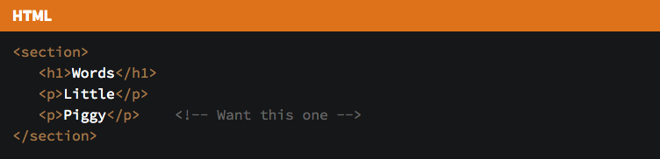
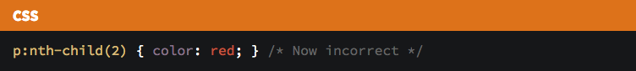
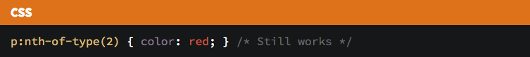
CSS: nth-child & nth-of-type
Notes:
Our :nth-child selector, in "Plain English," means select an element if:
It is a paragraph element
It is the second child of a parent
Our :nth-of-type selector, in "Plain English," means:
Select the second paragraph child of a parent

Slide 17
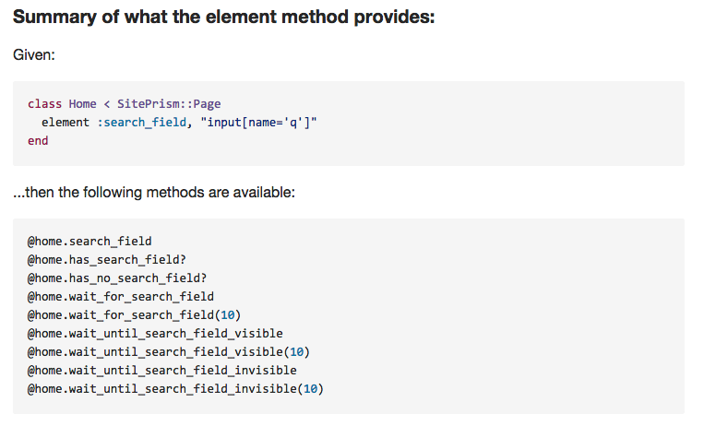
SitePrism

Slide 19
Capybara & SitePrism
Capybara
SitePrism
find(‘#name’)
all(‘#names’)
element(:user, ‘#name’)
elements(:names, ‘#names’)

Slide 20
Site Prism?
It does seem helpful
There is a lot of functionality for free
The napg_xtracker project has well written Page Objects & sections
Exposes Node Elements to the tests
Breaks a high level encapsulation of pages
It can get scary when there are many fields
Mixing CSS, XPath, Capybara DSL etc.
This is true for any approach which does not break up pages in sections
You can’t use CSS built at runtime with string concatenation
You may still need to use the Capybara DSL
Using ‘node element set’ does not trigger JavaScript events
The ‘fill_in’ method does
¯\_(ツ)_/¯
Notes:
http://stash.vm.wtf.nap/projects/TEST/repos/napg_fulcrum/browse/lib/fulcrum/page/marketing/voucher/create_voucher.rb
http://stackoverflow.com/questions/10825804/site-prism-capybara-selector-with-variable

Slide 21
Thanks
and maybe site_prism ain’t that bad…

